Slide 1



An optically pumped spin-exchange polarized electron source
Munir Pirbhai

Slide 2
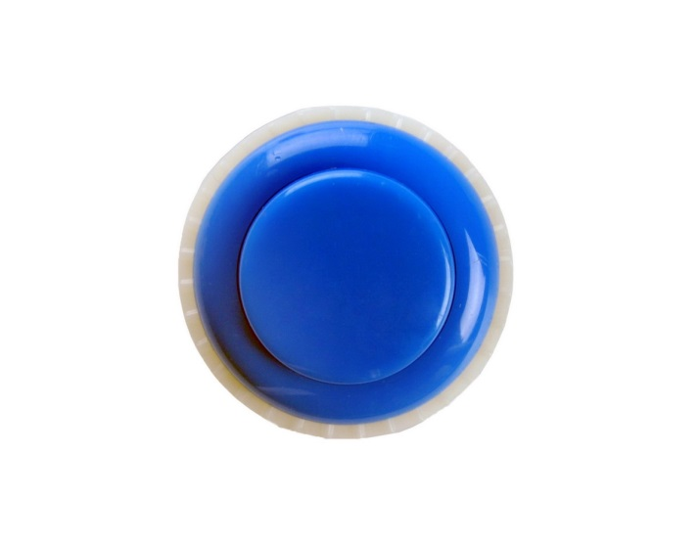
Wanted: a “push-button” polarized electron source
Desired characteristics:
Operates with less stringent vacuum requirements.
Less susceptible to contaminants.

Slide 3
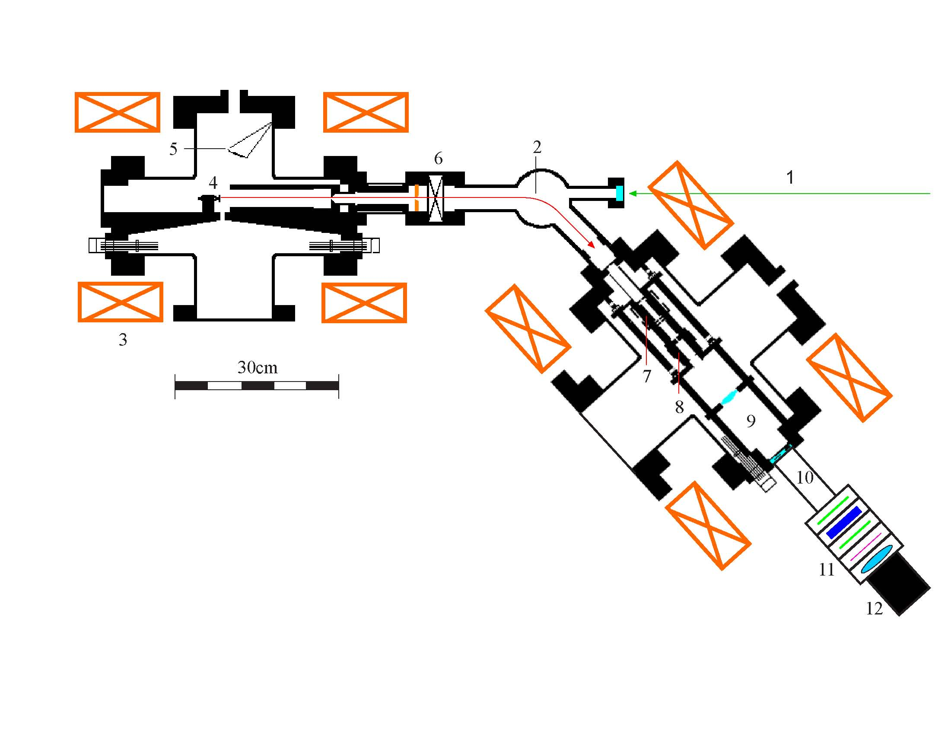
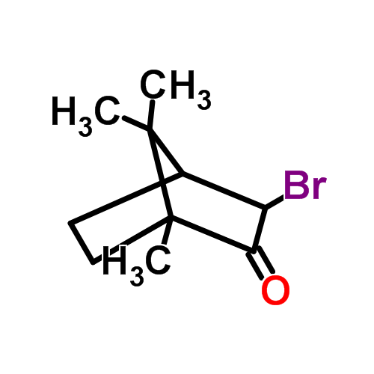
Example of an atomic physics “table-top” experiment: Electron circular dichroism
Source
Target
(bromocamphor)
J. M. Dreiling, private communication.
Notes:
5 mTorr

Slide 4
An idea for producing polarized electrons
P. S. Farago and H. Siegmann, Phys. Lett. 20, 279 (1966).
R. Krisciokaitis-Krisst et al., Nucl. Instrum. Methods 118, 157 (1974).
H.Batelaan et al., Phys. Rev. Lett. 82, 4216 (1999).
C.Bahrim et al., Phys. Rev. A 63, 042710 (2001).
Notes:
What technique is used to orient the rubidium atoms? Mention that we will come back to this in more detail later.

Slide 5
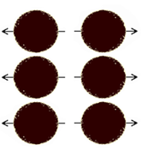
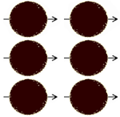
Working of the optically‐pumped spin‐exchange polarized electron source
Pump laser
Unpolarized
electrons
Polarized
electrons
Rb atoms
+ buffer gas

Slide 6
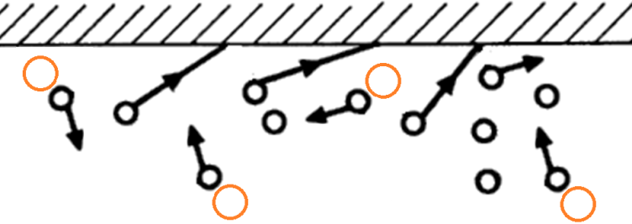
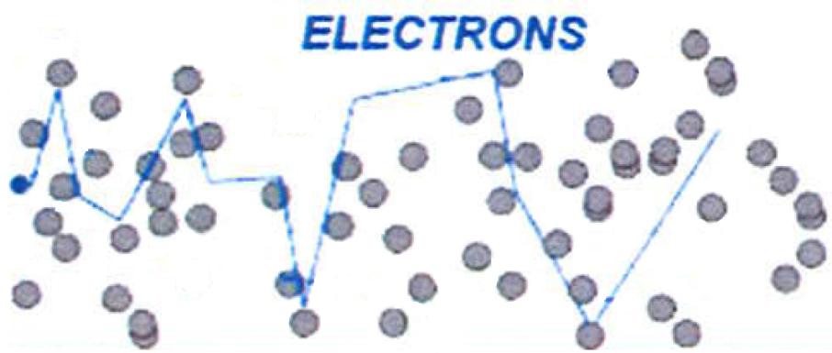
Role of buffer gas
Minimizes diffusion
Mitigates radiation trapping
Thermalizes electrons
Increases electron effective path length
H.Batelaan et al., Phys. Rev. Lett. 82, 4216 (1999).

Slide 7
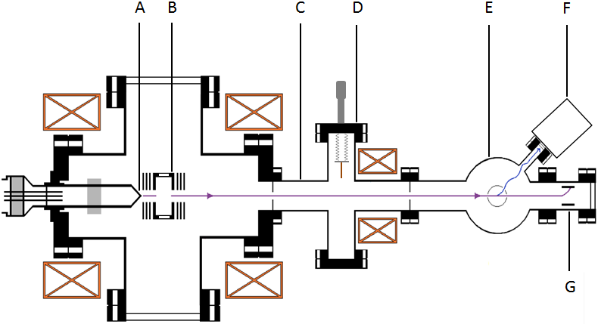
Schematic of apparatus
10cm
A) tungsten filament; B) collision cell; C) differential pumping chamber; D) retractable electron collector; E) electron polarimeter; F) optical polarimeter; G) Faraday cup

Slide 8
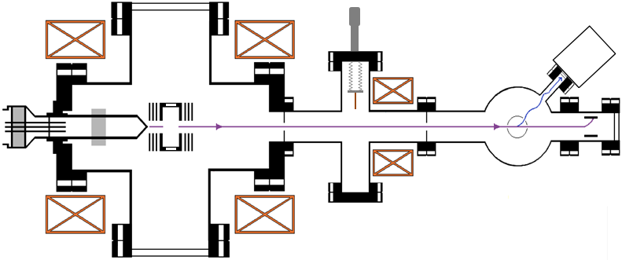
Optical layout
Probe laser
M
ND
LP
QWP
LP
M
M
Photodiode
Pump laser
(795nm)

Slide 9
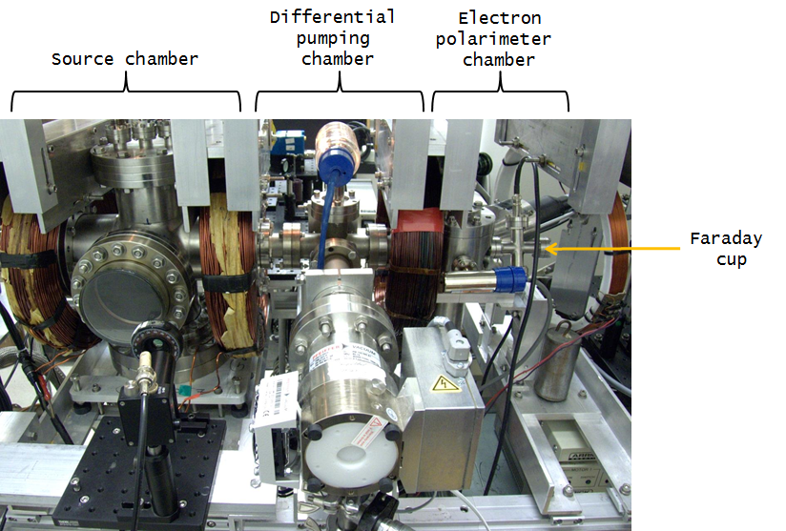
Apparatus
10cm

Slide 10
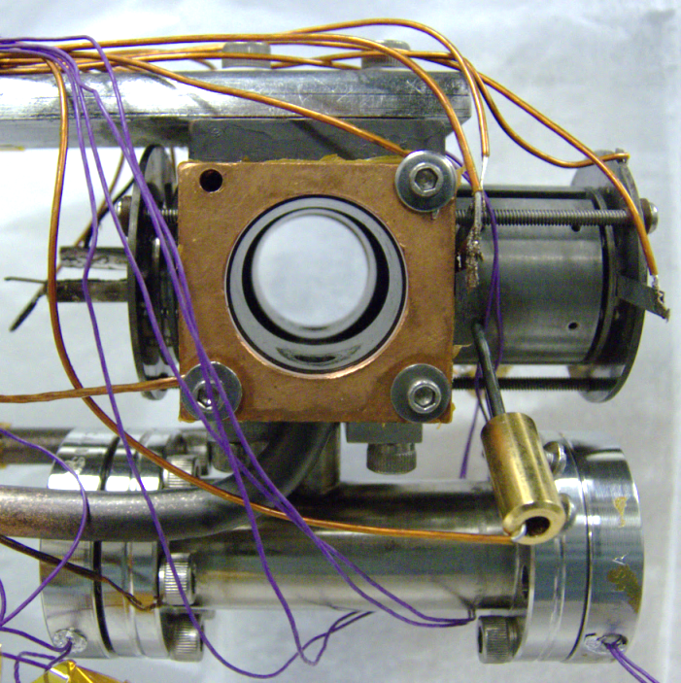
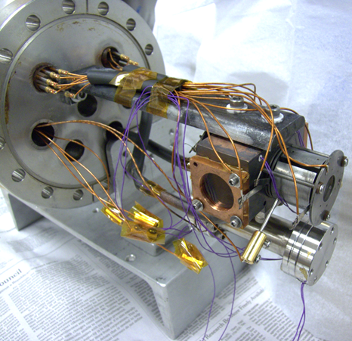
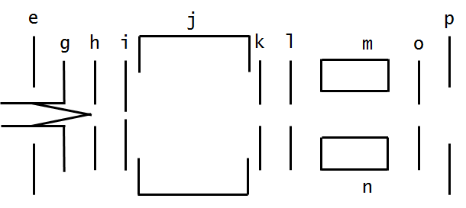
Source: collision cell/electron gun
Collision cell
Filament
Gas inlet
Pressure gauge
Rb reservoir

Slide 11
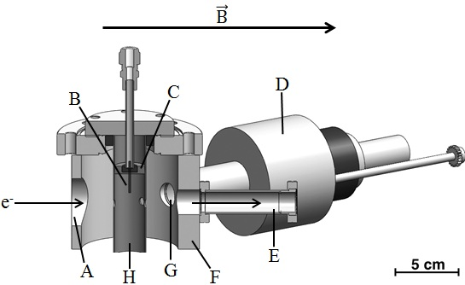
Optical electron polarimeter
A) entrance; B) target-gas-feed capillary; C) mounting sleeve; D) optical polarimeter; E) chamber housing electron collector and viewport; F) main vacuum chamber; G) fluorescence collection lens; H) energy-defining cylinder
T.J.Gay, J. Phys. B 16, L553 (1983).
M.Pirbhai et al., Rev. Sci. Instrum. 84, 053113 (2013).

Slide 12
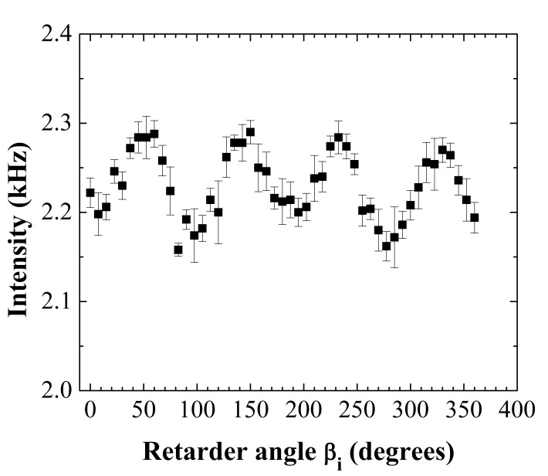
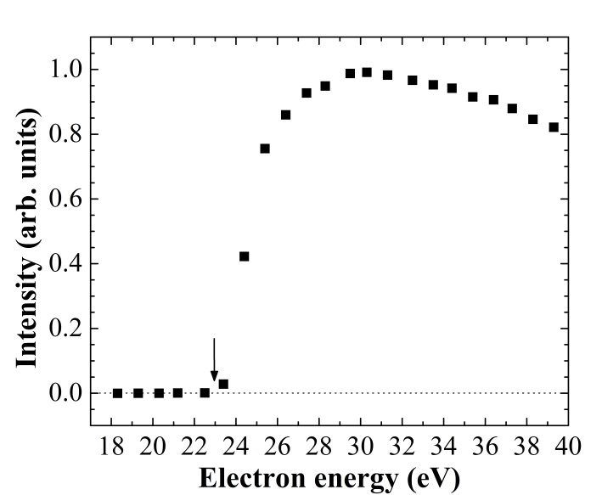
Electron optical polarimeter
Earlier optical polarimeters ~ 10⁻¹⁰
This device with argon gas ~ 10⁻⁸
High efficiency Mott ~ 10⁻⁴

Slide 13
Experiments
Electron-spin reversal phenomenon
Different buffer gases
Dependence on incident electron energy

Slide 14
Electron-spin reversal
E.B.Norrgard, D.Tupa, J.M.Dreiling, T.J.Gay, Phys. Rev. A 82, 033408 (2010).
Notes:
Maybe put E. Norrgard’s reference here.

Slide 15
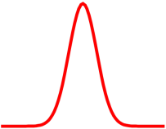
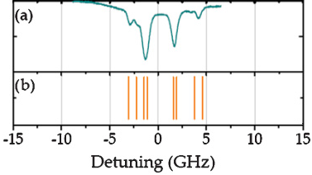
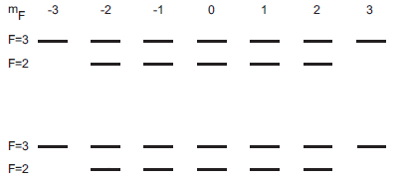
Experiment 1: Electronic spin reversal
+
⁸⁷Rb
2→1
2→2
^{F = 3}
^{I = 5/2}
^{S = 1/2}
^{I}
^{S}
⁸⁷Rb
1→1
1→2
⁸⁵Rb
3→2
3→3
⁸⁵Rb
2→2
2→3
^{F}

Slide 16
Experiment 1: Electronic spin reversal
+
⁸⁷Rb
2→1
2→2
⁸⁷Rb
1→1
1→2
^{F = 2}
^{I = 5/2}
^{S = 1/2}
^{I}
^{S}
⁸⁵Rb
3→2
3→3
⁸⁵Rb
2→2
2→3
^{F}

Slide 17
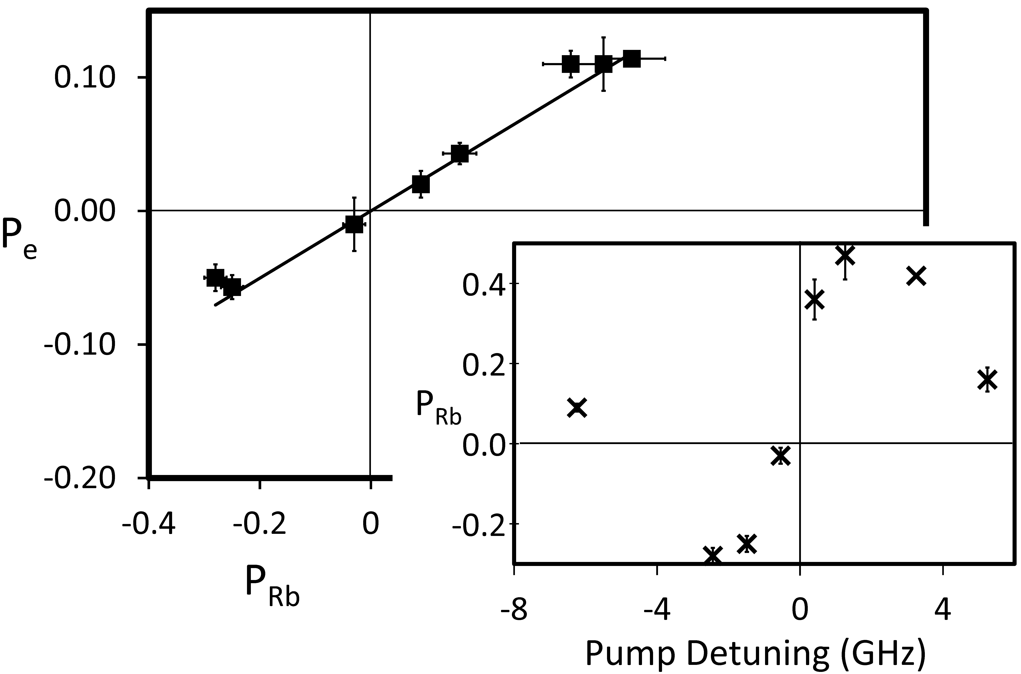
Experiment 1: electron-spin reversal
⁸⁷Rb
2→1
2→2
⁸⁷Rb
1→1
1→2
⁸⁵Rb
3→2
3→3
⁸⁵Rb
2→2
2→3
Notes:
This gives us another handle on reversing the polarization on the electron beam.

Slide 18
Experiment 1: two ways to reverse beam polarization
Optical helicity
Pump wavelength detuning
Notes:
This gives us another handle on reversing the polarization on the electron beam.

Slide 19
Different buffer gases:
He
H₂
N₂
C₂H₄
E_{i}~2eV
E_{i}~4eV
Notes:
All buffer gases are equal, but some are more equal than others.

Slide 20
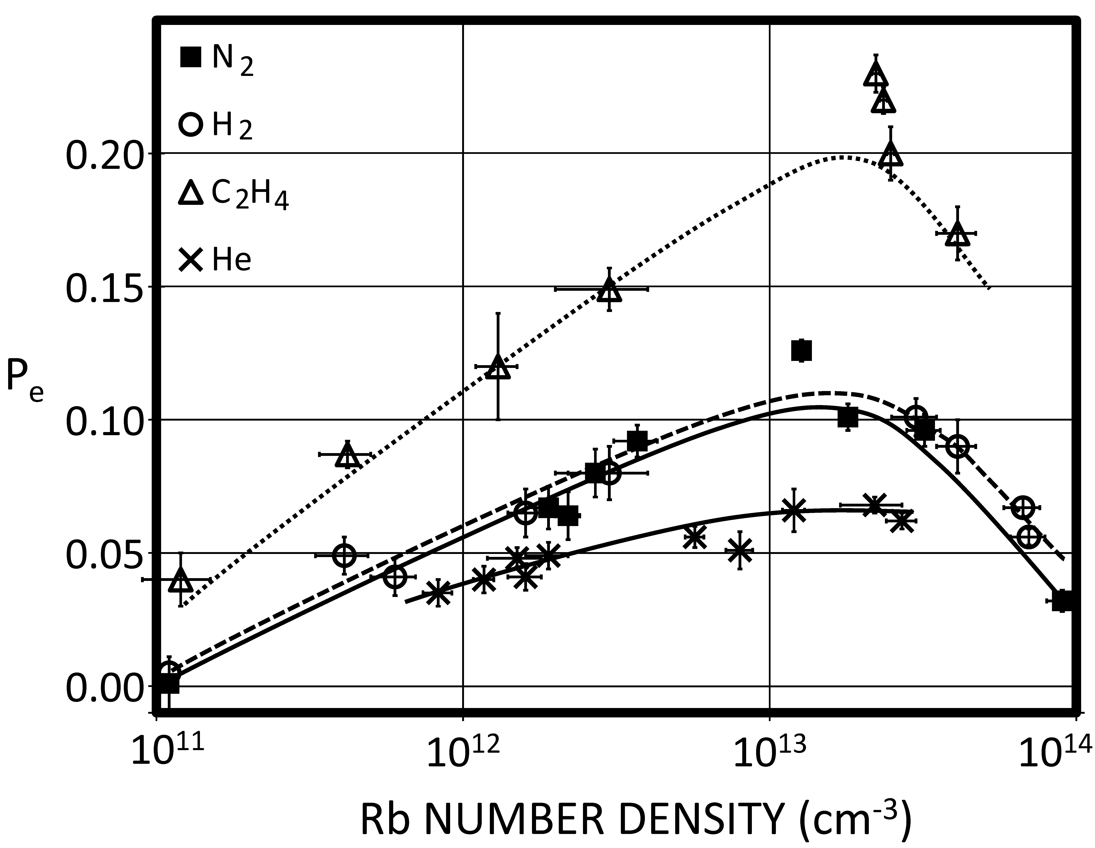
Experiment 2: performance with different buffer gases
P_{e}~24%; I~4μA
GaAs source on
ECD experiment
Notes:
This 4 microamps with 24% polarization is now comparable to the performance of the GaAs source we get on the experiment using chiral molecules and other nasty chemicals as targets.

Slide 21
Experiment 2: characteristics of the different buffer gases
Gas | Quenching cross-section (Å²)
Ethylene | 139
Helium | ˂˂ 1
Hydrogen | 6
Nitrogen | 58
W.Happer, Rev. Mod. Phys. 44, 169, (1972).
J.M.Warman and M.C.Sauer, J. Chem. Phys. 62, 1971 (1975).

Slide 22
Energy dependence of P_{e}

Slide 23
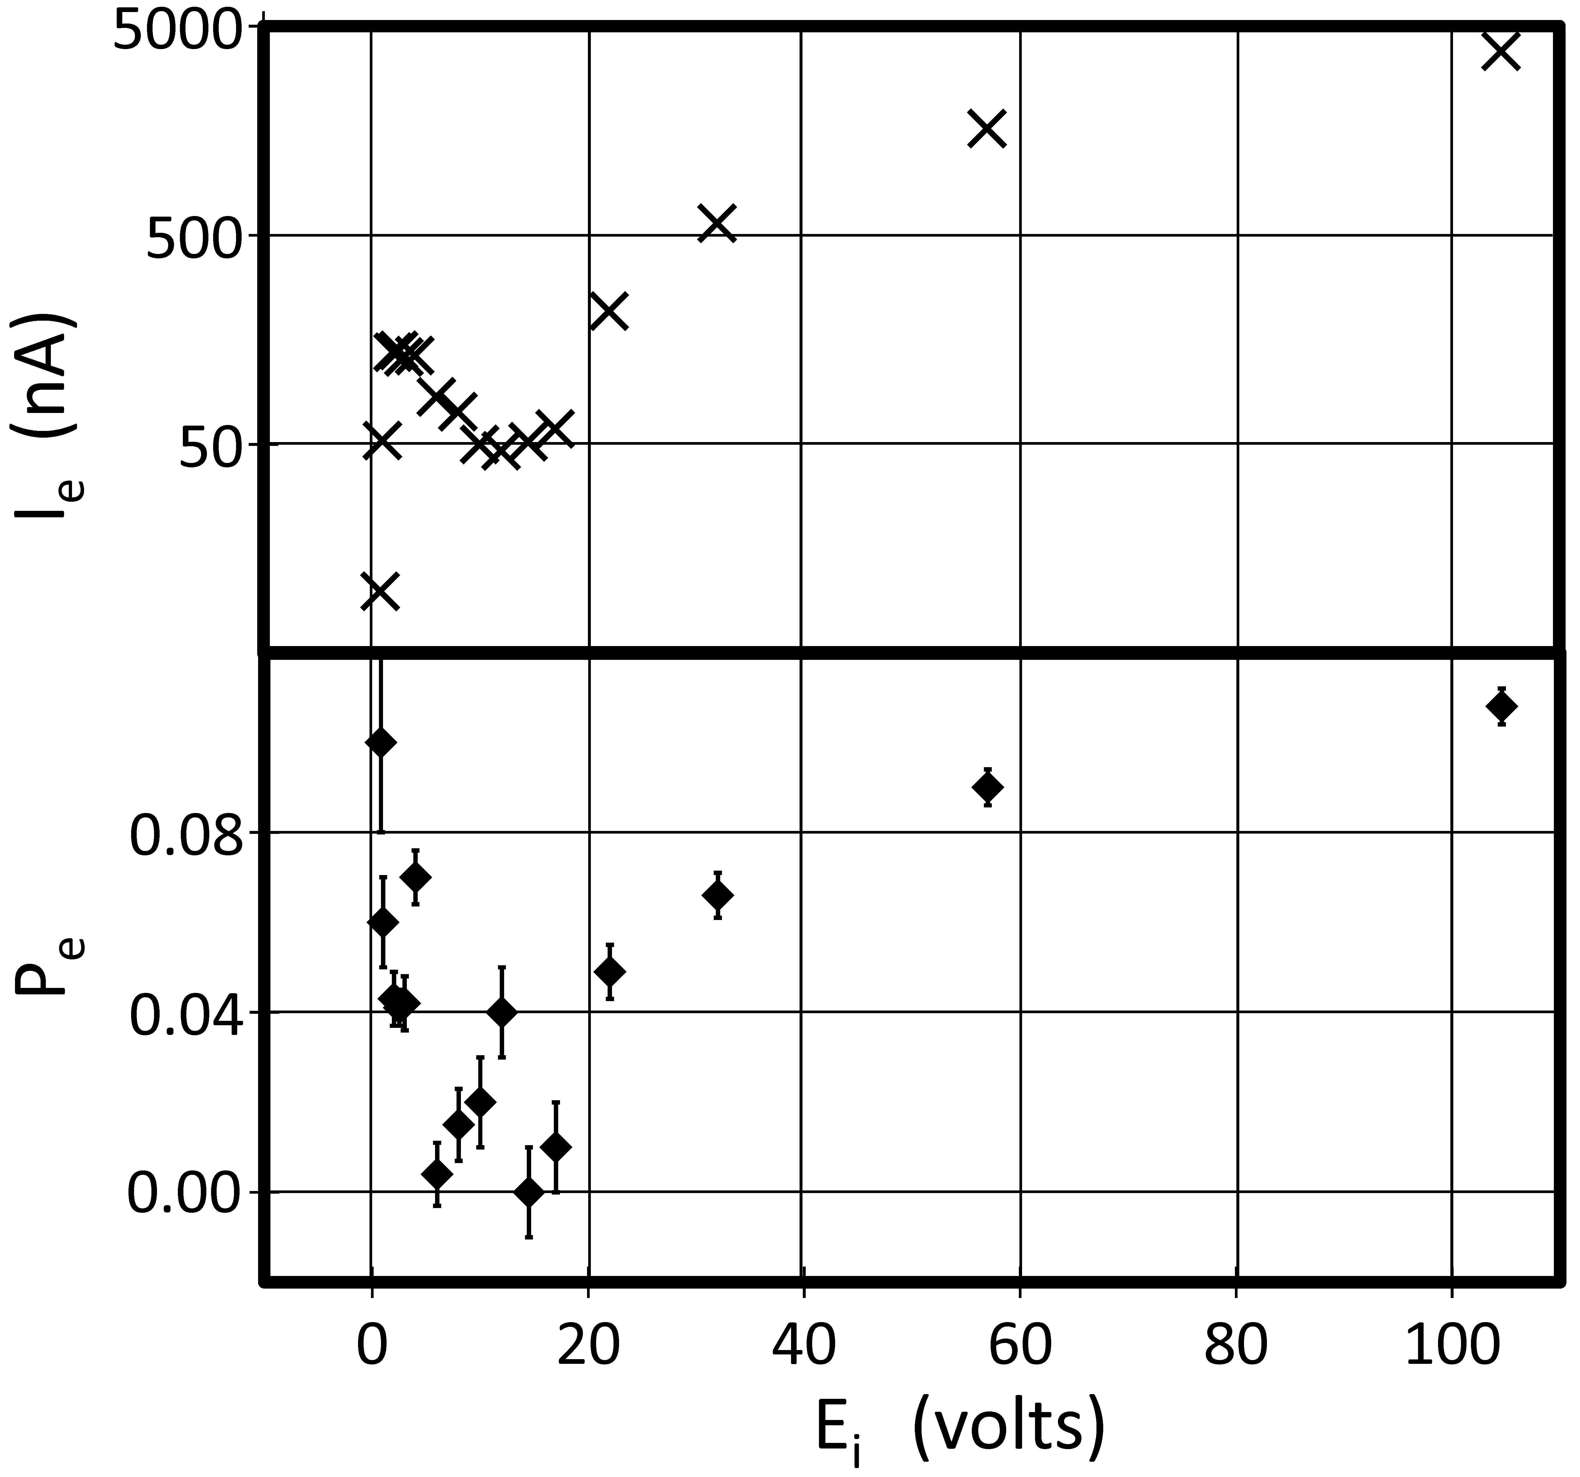
Experiment 3: dependence of P_{e} on electron energy

Slide 24
Experiment 3: dependence of P_{e} on electron energy

Slide 25
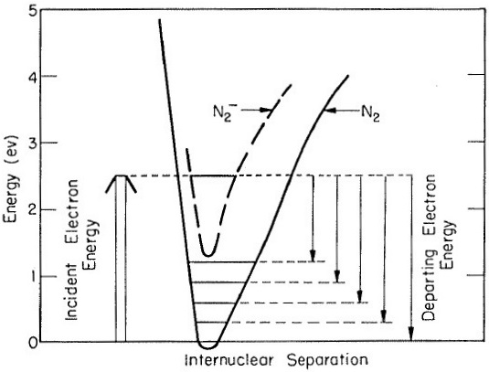
Experiment 3: temporary negative ion formation
G.J.Schulz, Phys. Rev. 116, 1141 (1959).

Slide 26
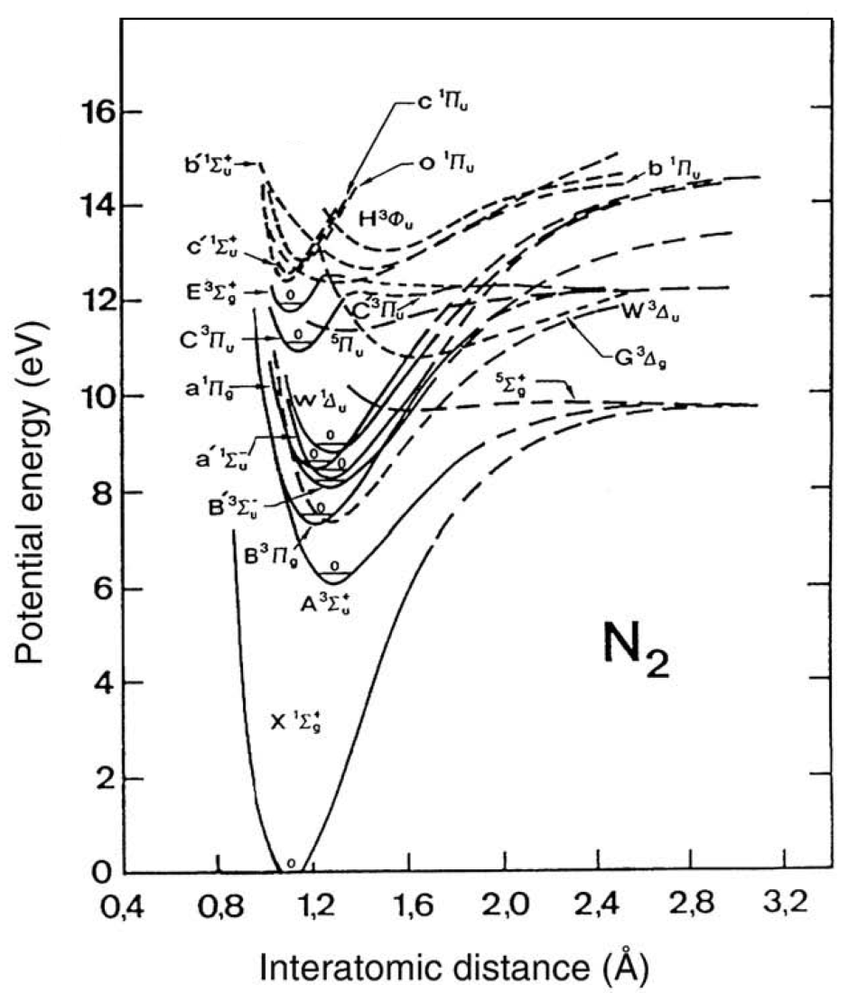
Experiment 3: electronic excitation
A. Bogaerts, Spectrochim. Acta Part B 64, 129 (2009).

Slide 27
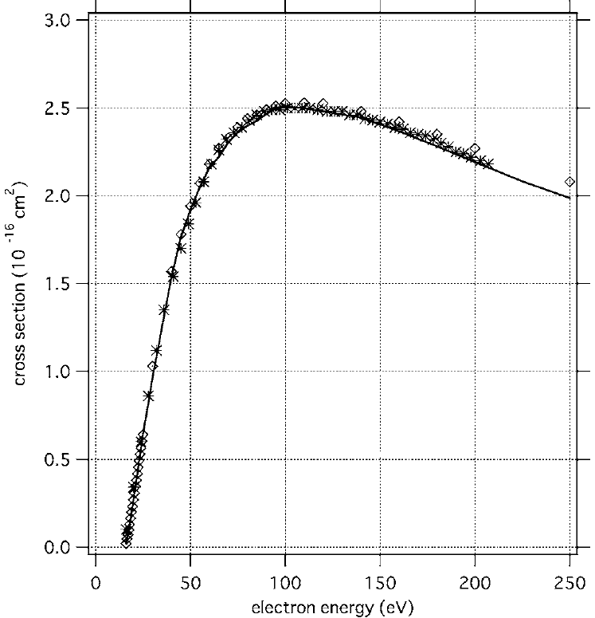
Experiment 3: ionization
Y.Itikawa, J. Phys. Chem. Ref. Data 35, 31 (2006).

Slide 28
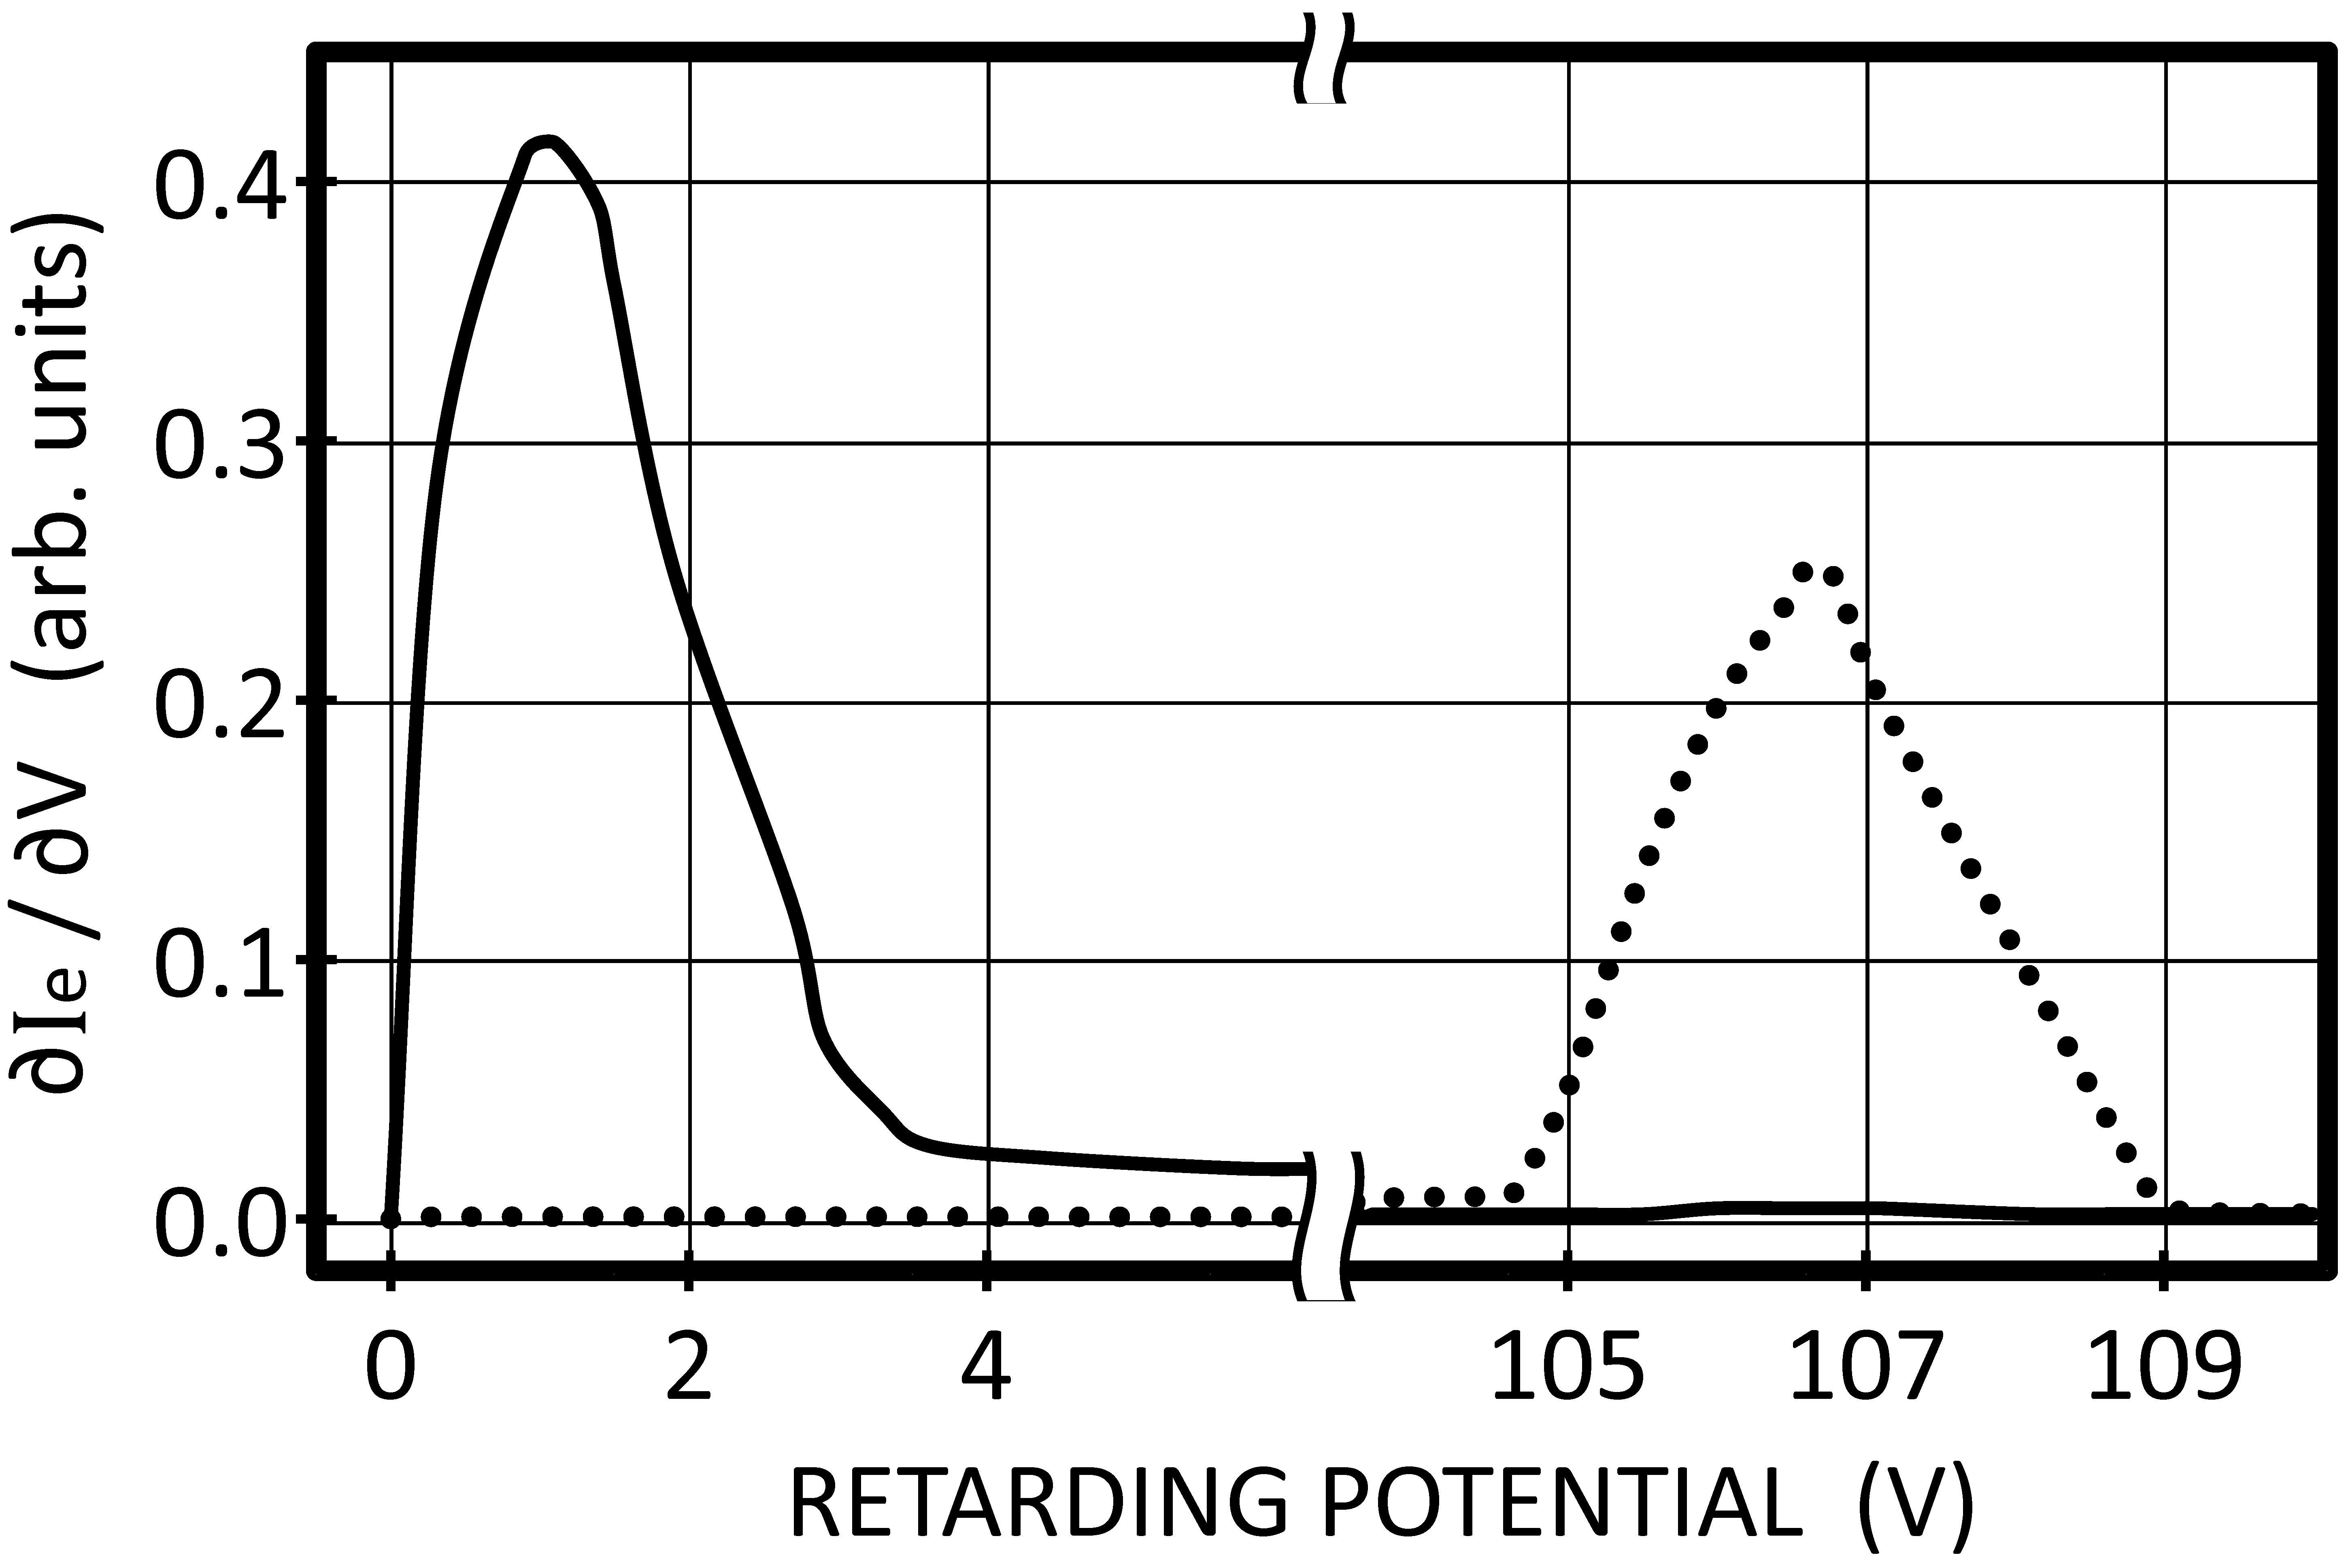
Experiment 3: retarding field analysis
With gas
No gas
C. B. Opal et al., J. Chem. Phys. 55, 4100 (1971).

Slide 29
Future improvements
Repump laser
Benzene as buffer gas
Higher buffer gas pressure
Rubidium dispensers
R.G.W.Norrish and W.MacF.Smith, Proc.Roy.Soc.London A176, 295 (1940).

Slide 30
Praise the bridge that carried you over.
— George Colman
Timothy J. Gay
Paul D. Burrow
Dale Tupa (LANL)
Eric T. Litaker
Jonah Knepper
Herman Batelaan

Slide 32
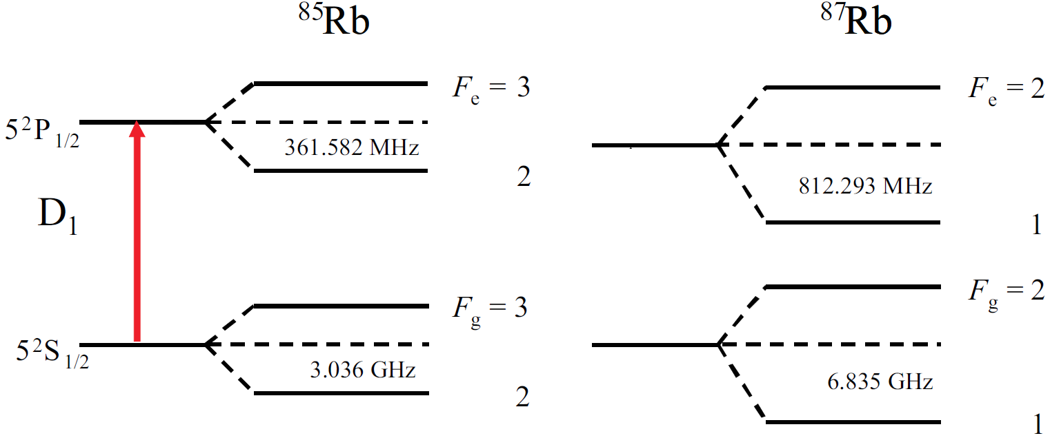
Experiment 1: Rubidium D1 transitions
(72%)
(28%)
D1
794.979 nm
377.11 THz
P. Siddons et al., J. Phys. B 41, 155004 (2008)

